Slide 1

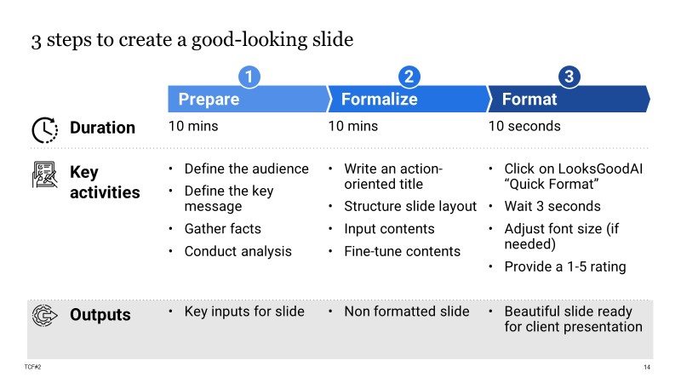
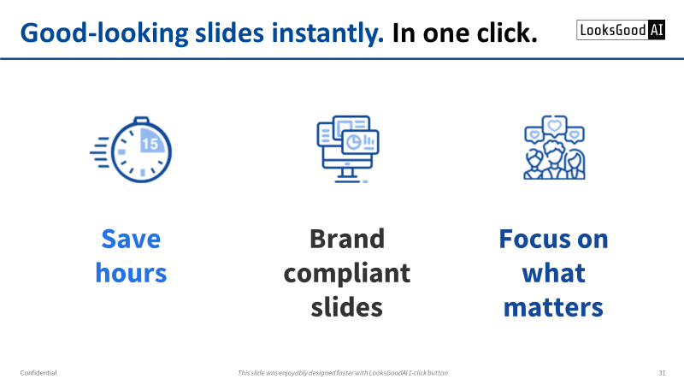
Investor Pitch Deck
We set-up a R&D partnership with LooksGoodAI, providing data and funding, because it’s the only relevant AI tech to address our consultants and graphists needs
Global Head of Slide Production Services at a top-consulting firm

Slide 2

Let’s start with some Q&A (1/4)
Have you already spent too much time formatting a business presentation?

Slide 3
Let’s start with some Q&A (1/4)
You’re like 150M professionals, who format slides daily.
We know it’s a tedious task, wasting your valuable time on aligning boxes.
It happens in many industries and functions, consulting in particular.
Have you already spent too much time formatting a business presentation?

Slide 4
Let’s start with some Q&A (2/4)
How big of an issue is slide formatting in consulting?

Slide 5
Let’s start with some Q&A (2/4)
Top consulting firms offshore/outsource 10% of their staff as dedicated graphists formatting slides.
Yet, consultants still spend an additional 5-10% of their time formatting slides.
Slide formatting is a 300+M USD annual cost issue at one of our top consulting firm partner.
How big of an issue is slide formatting in consulting?

Slide 6
Let’s start with some Q&A (3/4)
Did you know that a PowerPoint add-in did a $1.2Bn unicorn exit?

Slide 7
Let’s start with some Q&A (3/4)
Think-cell is a PowerPoint add-in to quickly create nice graphs.
It has 1M end-users across 25K accounts, with a B2B license cost of up to 300 USD per user.
Cinven acquired it for 1.2Bn USD in 2021.
Did you know that a PowerPoint add-in did a $1.2Bn unicorn exit?

Slide 8
Let’s start with some Q&A (4/4)
What is the potential of a GenAI start-up that instantly formats slides in 1-click?

Slide 9
Let’s start with some Q&A (4/4)
That’s what we do at LooksGoodAI.
Our product is deployed live at top consulting firms (data access, technology and GtM are de-risked)
We dream BIG.
Today, you have an opportunity to invest!
What is the potential of a GenAI start-up that instantly formats slides in 1-click?

Slide 10
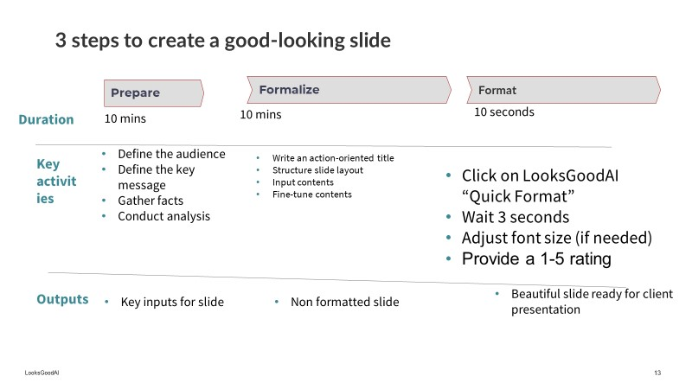

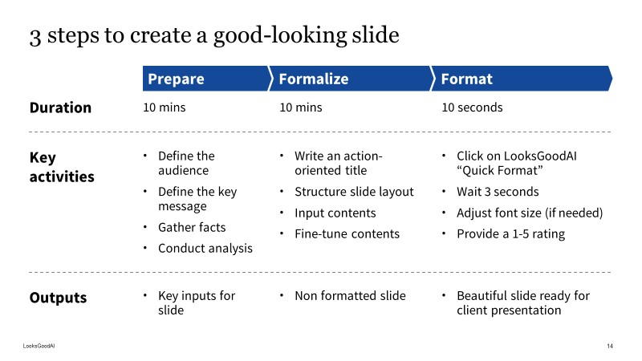

For 150M professionals, formatting slides is a daily hurdle
A typical slide requiring formatting
A slide ready for
professional presentation
It’s tedious, time consuming and unfit to core skills

Slide 11



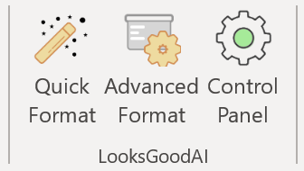

LooksGoodAI delivers good-looking slides instantly, in one click
A typical slide requiring formatting
A slide ready for
professional presentation
03
sec
1-click in user’s preferred environment
Save hours. Get brand compliant slides. Focus on what matters.

Slide 12
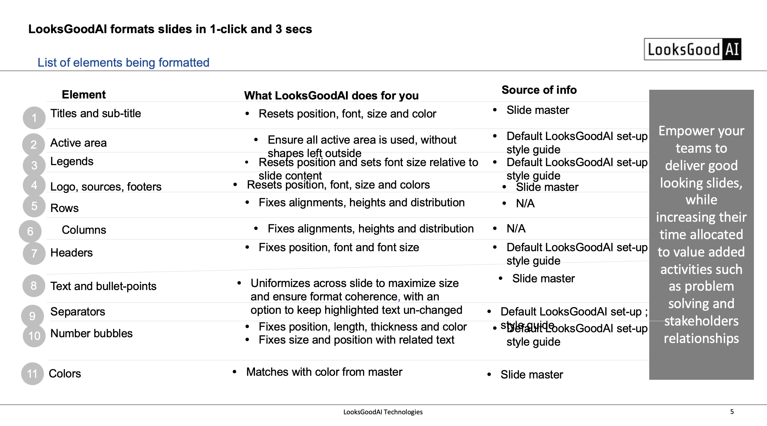
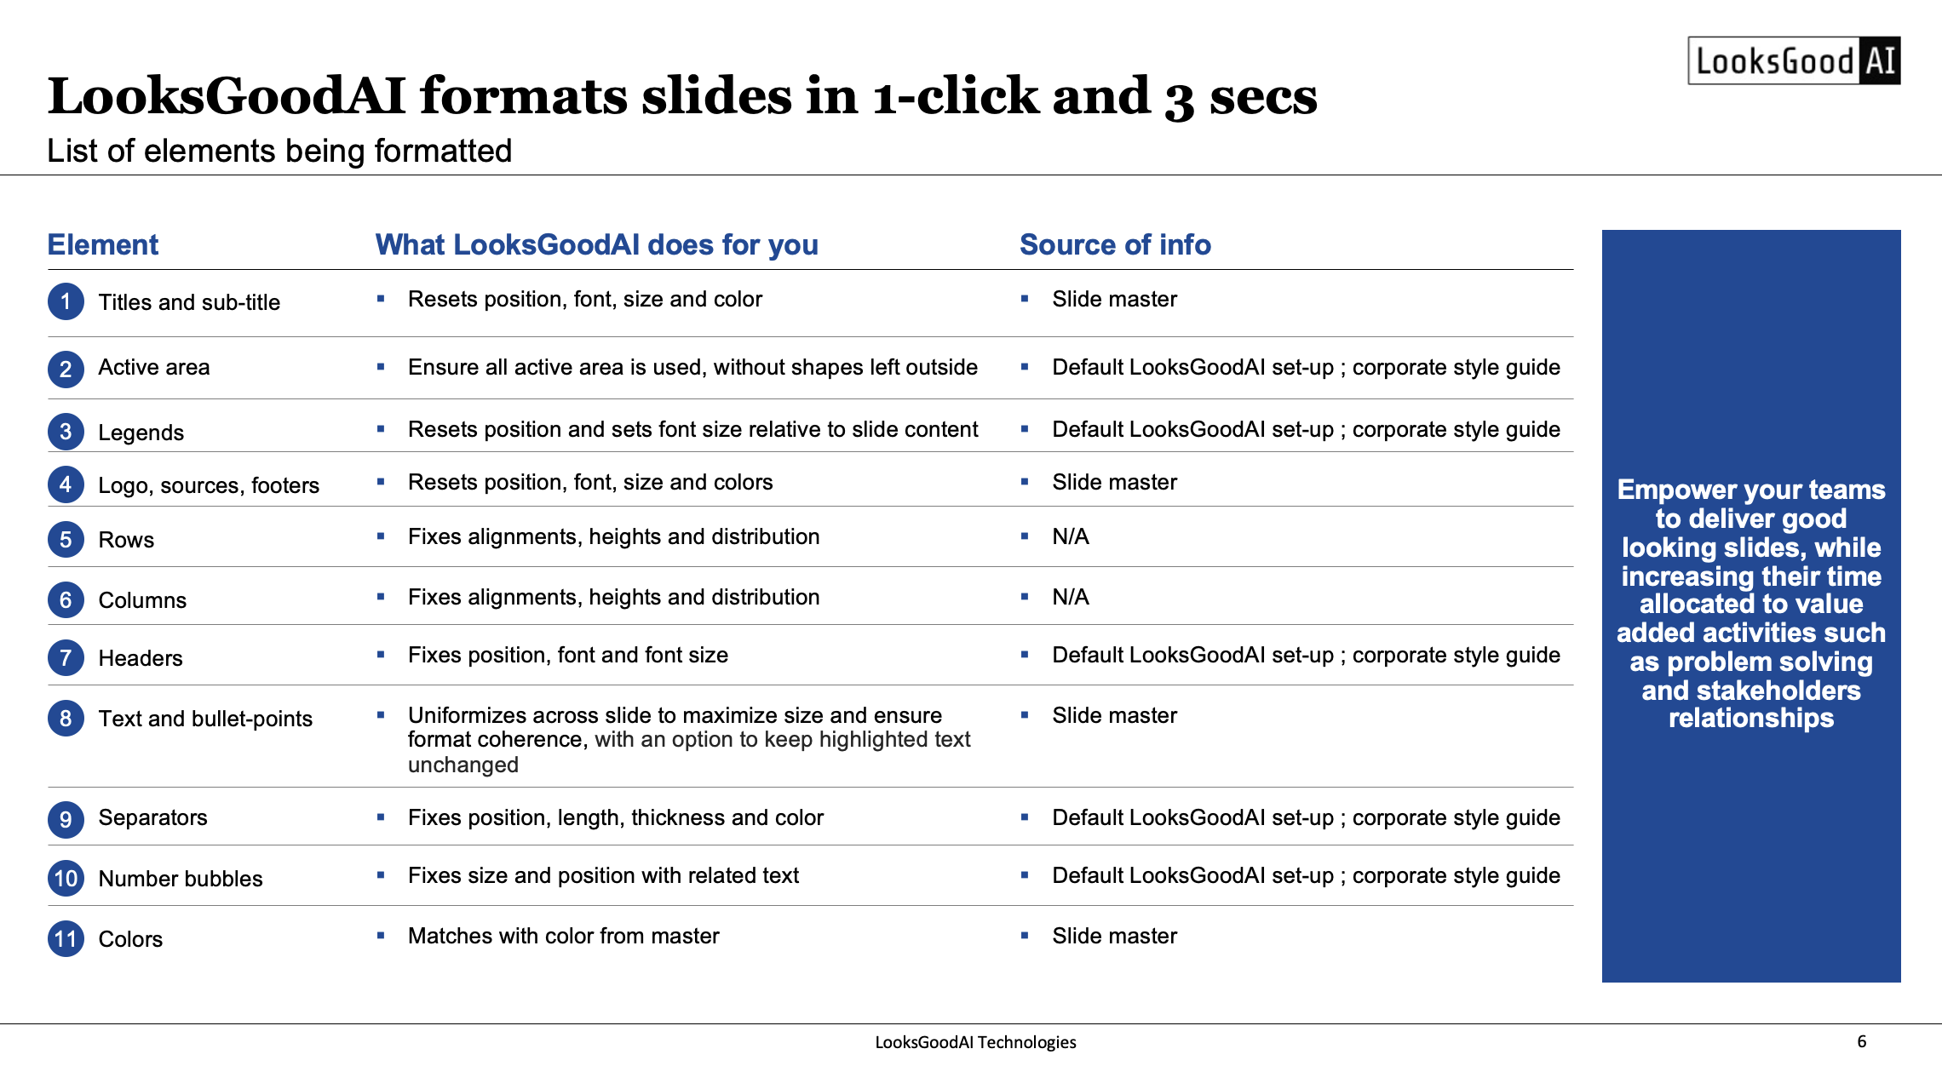



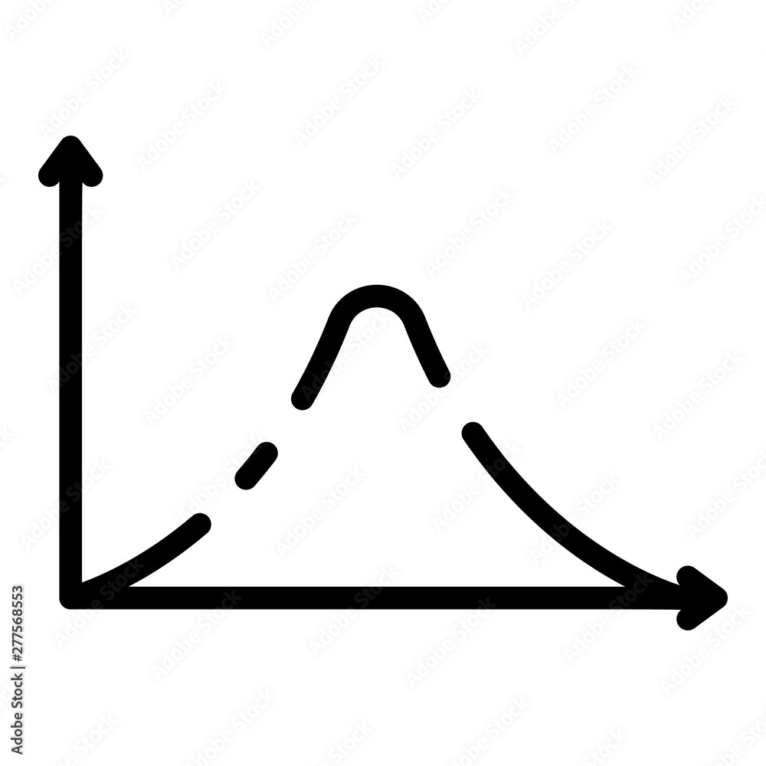
LooksGoodAI has a patent-pending revolutionary AI technology
Input X
AI
Output Y
Data
Detection
Transformation
Optimisation
20K+ before and after slides labeled by top consulting graphists (e.g., these shapes are part of a column)
80+ ML-trained and heuristic models to detect slide structures (e.g., these shapes are part of a legend)
160+ formatting transformation rules embedded in a state-of-the-art rule solver engine (e.g., align top all shapes of a row)
Ad-hoc algorithms to optimize multi-variable formatting (e.g., row height x column width to maximize font size)

Slide 13
In 2023, we doubled LooksGoodAI productivity gains, again!
LooksGoodAI slide formatting productivity gains on a sample document
Gross productivity gains, %¹
Re-engineering
Est. 43-45%
39%
Legacy
32%
22%²
15%
10%
7.5%
2021Q4
2022Q2
2022Q4
2023Q2
Sept 2023
Dec 2023
Feb 2024
1: Top consulting firm visual graphists specialists measured 2: shift from legacy 300 sample deck to new 200 sample deck, measured with 2022Q4 version

Slide 14
We have top consulting firms’ partnerships and clients globally
$600K R&D revenues received in 2020-23 and $1.25M ARR in signed contracts upon full deployment
1
Global consulting firm (partner since 20Q1)
$500K invested in R&D
$1.1M ARR once deployed at scale
Royalty free data access to millions of slides
Deployed at 125 slide production graphists and 50 consultants
Proven productivity gains of 10% in live pilot, above threshold to deploy at scale
Countries with active users, clients or prospects
X
3
1
X
1
2
BIG4 consulting office (partner since 22Q1)
$100K invested in R&D, $60K ARR
Full deployment to 600 consultants in 22Q4
2
1
1
X
X
3
BIG4 consulting office (signed since 23Q3)
Ready to pilot and deploy 600 consultants at $60K ARR with next version of LooksGoodAI
X
X
Dozens of 5-50 employees consulting firms and slide formatting outsourcers clients or confirmed interest prospects

Slide 15
Our pricing is simple and follows a profitable value-based logic
Example for
B2B SaaS at $300 (in 2023) to $500 (in 2030) annually per user
In line with established PowerPoint add-ins pricing (e.g., think-cell)
Delivers over 20X in productivity gains relative to license price, with room to increase over-time
Current cost of slide formatting
Cost saving with LooksGoodAI
LooksGoodAI
license fee
$150M
$60M
$3M
10K consultants
$150K cost per consultant
10% of time on slide formatting
40% productivity gain
$300 target ARPU
20x ROI

Slide 16
We target consulting first, with potential to reach other verticals
Level of priority
Core
High
Medium/Low
Daily professional slide writers
150M users¹ = $45Bn TAM⁴ = Unicorn @0.2% penetration⁵
Consulting and professional services
15M users² = $4.5Bn TAM⁴ = Unicorn @2% penetration⁵
Financial services
Top 50 firms
2M users³ = $400M ARR⁴ = Unicorn @25% penetration⁵
Corporates
Mid-market
Education
Boutique firms
Others
Slide formatting outsourcers
1: 750M license holders of slide edition software (derived from Microsoft annual report) with 20% of license holders being daily professionals
2: Conservatively estimated to 10% of daily professional slide writers, various sources give a range between 3M and 100M consultants and professional services employees worldwide
3: Bottom-up estimate from number of employees at top consulting and audit firms and share of employees using PowerPoint daily
4: Conservatively assuming $300 ARPU, with 33% volume discount on top 50 firms ; 5: Assuming 10X valuation on ARR

Slide 17


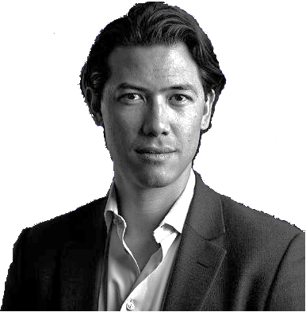




Our team understands consulting and has cutting-edge AI skills
Founder
Full-time team
Investors
Jean-Elie Aron
CEO
McKinsey (8 years) and CapGemini (1 year) alumni
Yassine Bouabdallaoui
Data scientist
PhD, Engineer
Our 2 VC and 29 angels investors bring a breadth of valuable expertise, among them:
Partners at McKinsey, BCG, Strategy& and Bain (current or alumni)
Strategic Partnership Director at Microsoft
SVP in CyberSecurity
Senior executive in AI consulting
Founder of OpenOffice support provider
Founder of slide formatting outsourcer
Entrepreneurs
Thomas Barbare
Front-end
Engineer
Key advisors
Yves Boussemart
Technology advisor
QuantumBlack co-founder
Ophelie Touchard
Front-end
Engineer
Carine Cassir
Strategy advisor
ScalingUp coach
Mehdi Alaoui Back-end and cloud
Engineer
Aafaf Arharas Back-end
Engineer

Slide 18










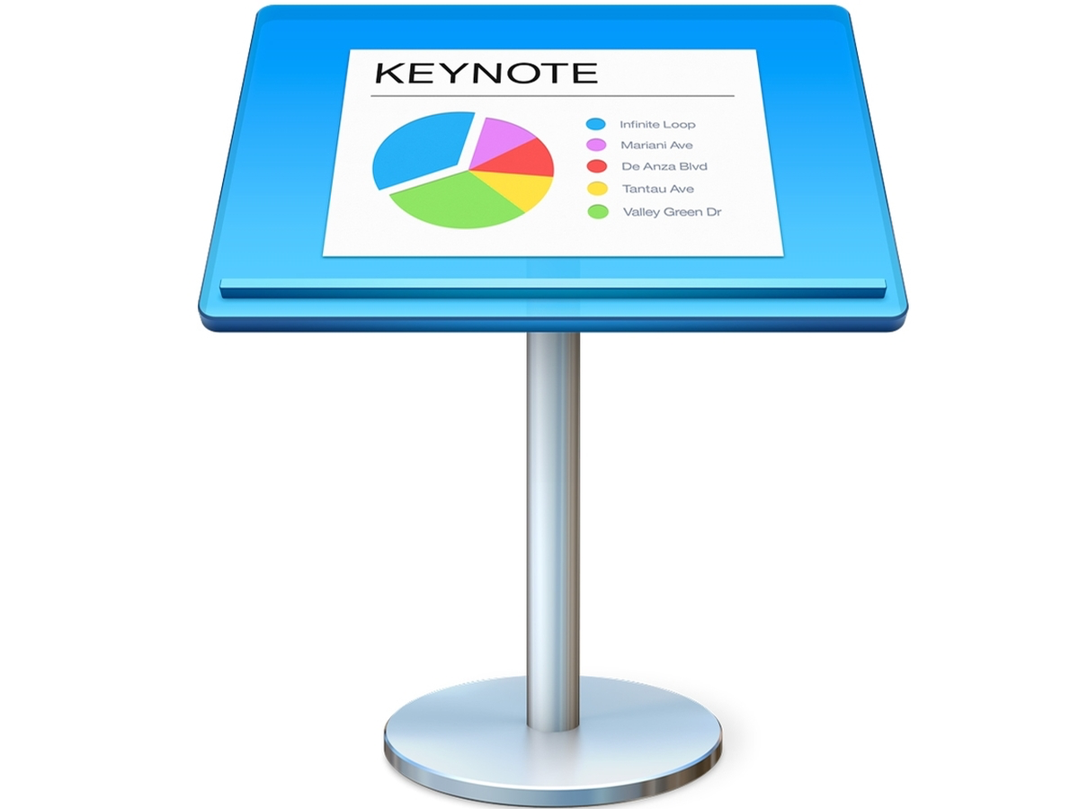









Contrary to think-cell, we evolve in a “blue ocean” ecosystem
Slide edition
Software
(= ecosystem)
Manual slide improvement tools
( = potential distribution partners)
Automated slide improvement tools (= competition)
‘Design Ideas’
(simple non-business slides only)

Slide 19
So far we have outmatched our main direct competitor
Data access
Exclusive access to large, highly relevant datasets of slides
Small datasets of slides handed by clients
Technology
Vision, plan and team to make the most of latest advances in Deep Learning
Basic Machine Learning for closest fit to a pre-set repository of slides
UI/UX
1-click button, 3 seconds
Complex toolbar, 15 seconds
Competitive deals
LooksGoodAI has prevailed 3 times over DeckRobot thus far:
2020: global consulting firm MVP partnership deal
2020: OneWay Ventures seed funding deal
2022: global consulting firm MVP partnership deal (2 countries)

Slide 20
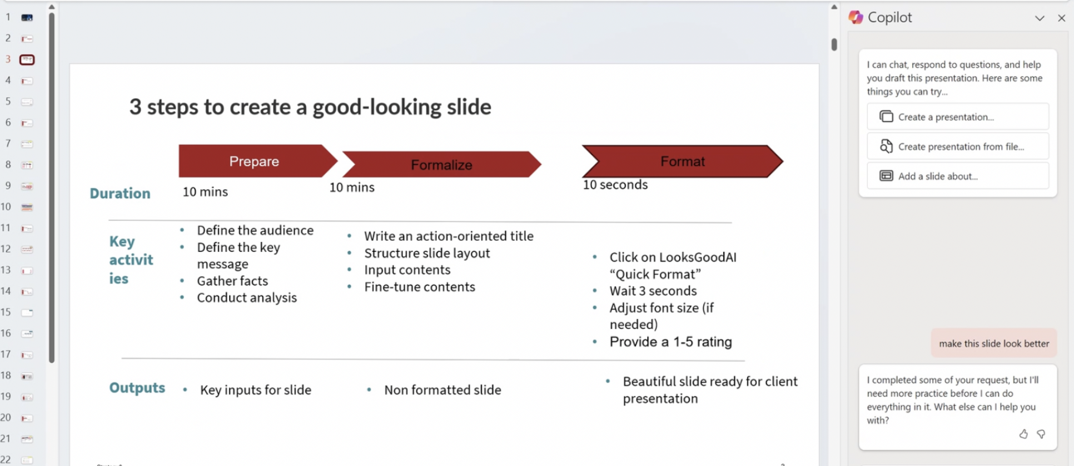

MS Copilot is complementary, not competitive
As an LLM, Copilot is not suited to format slides on which LooksGoodAI excels

Slide 21
We’re raising $500K to secure our 2024 runway
Key goals in 2024
Effort
1
Get from 40% to 60% productivity gains with a new big-data, transformer-based generative AI technology
60%
2
Develop new product features our clients dream about
20%
3
Build an efficient sales engine and grow our ARR to Series A ready levels
20%

Slide 22
We aim for 60% productivity gains with a transformer-based AI
1
Goal: 2X LooksGoodAI slide formatting productivity gains
Approach: progressively integrate latest state-of-the-art in generative AI technology
60%
Expand training dataset from 30K labelled slides to 1M un-labelled pairs of slides (already acquired)
Data
40%
Evolve from classic ML-training + rule base AI to state-of-the-art generative AI based on deep-learning transformers (GPT-like)
AI
2023Q4
2024Q4 (goal)

Slide 23
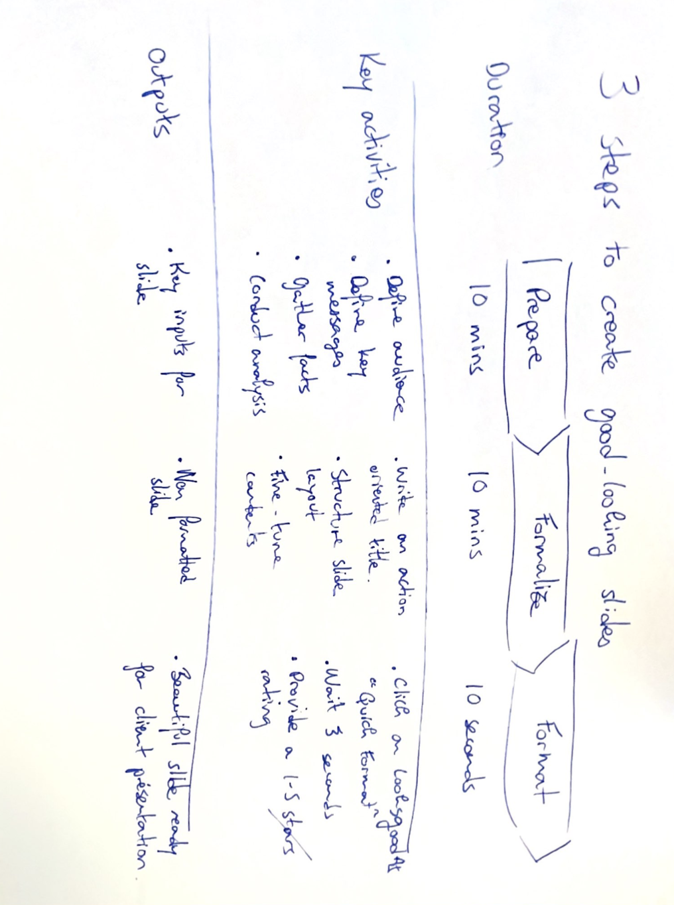
Our clients dream about products on our roadmap
2
Picture to slide
High-end beautification

Slide 24
Our GtM will target all segment sizes in a cost-efficient way
3
Core
Secondary
GtM channel
External
Resellers, Freelance
Partnership
X-sell (think-cell, Microsoft)
Online (incl. Office Add-ins store)
Word of mouth
(e.g., alumni consulting)
Direct
B2B sales
Segment
ARR
Users
Very large
$1.5M
5 000
Sales senior
Large
$150K
500
Sales senior
Medium
Pre-sales
Sales junior
$15K
50
Small
$1.5K
5
Sales junior
Focus on sectors/function with high proportion of daily professional slide writers:
professional services, education, marketing, sales, internal consulting, …

Slide 25
We have a clear roadmap to meet our 5-year ARR goals
3
LooksGoodAI planned year-end-ARR (M USD)
$150M ARR = 33% penetration on top 50 consulting and audit firms
Sales engine powered by X-sell partnerships, word of mouth and online (on top of B2B direct)
$2M ARR in 2024 + $8M ARR in 2025 on named accounts with entry-points already identified/involved in pre-product discussions³
$1.25M ARR in contracts already signed¹
$0.75M ARR in active discussions²
150
75
30
10
2
2024
2025
2026
2027
2028
1: signed contracts, ARR to occur upon deployment to all end-users at these 3 accounts
2: discussions with 2 top-consulting firms in progress, each worth over $0.75M
3: previously engaged preliminary discussions with 10 consulting firms who confirmed interest for more advanced versions of LooksGoodAI product

Slide 26

Good-looking slides in 1-click
We look forward to have you embark on a journey with us

